Slide 1

CMR COLLEGE OF ENGINEERING & TECHNOLOGY
Kandlakoya, Medchal, Hyderabad - 501401
Department of Computer Science and Engineering
Cyber Bullying Detection Using Machine Learning
Batch No.:09
Name of the student:
B. Shravya (20H51A05B5)
P. Sreenidhi (20H51A0521)
K. Rahul (20H51A0538)
Under esteemed guidance of
Dr. G. Ravi Kumar
Associate Professor
Batch: 2020-2024 Major Project Phase 1

Slide 2
Outline
Abstract
Introduction
Research Objective
Problem Definition
Scope of the Project
Literature Review
Implementation of Existing system
Conclusion
References
Notes:
2

Slide 3
Abstract
Notes:
3

Slide 4
ABSTRACT
Prior to the innovation of information communication technologies (ICT), social interactions evolved within small cultural boundaries such as geo spatial locations. The recent developments of communication technologies have considerably transcended the temporal and spatial limitations of traditional communications.
These social technologies have created a revolution in user-generated information, online human networks, and rich human behavior-related data. However, the misuse of social technologies such as social media (SM) platforms, has introduced a new form of aggression and violence that occurs exclusively online.
The motivations for the construction of prediction models to fight aggressive behavior in SM are also outlined.
We comprehensively review cyber bullying prediction models and identify the main issues related to the construction of cyber bullying prediction models in SM.

Slide 5
INTRODUCTION
Notes:
5

Slide 6
Introduction
Machine or deep learning algorithms help researchers understand big data . Abundant information on humans and their societies can be obtained in this big data era, but this acquisition was previously impossible .
One of the main sources of human-related data is social media (SM). By applying machine learning algorithms to SM data, we can exploit historical data to predict the future of a wide range of applications.
Machine learning algorithms provide an opportunity to effectively predict and detect negative forms of human behavior, such as cyber bullying . Big data analysis can uncover hidden knowledge through deep learning from raw data.
Big data analytics has improved several applications, and forecasting the future has even become possible through the combination of big data and machine learning algorithms .
Notes:
6

Slide 7
Research Objective
Notes:
7

Slide 8
Research objective
To detect aggressive behavior on SM websites by using machine learning approaches.
We specifically reviewed four aspects of detecting cyber bullying messages by using machine learning approaches, namely, data collection, feature engineering, construction of cyber bullying detection model, and evaluation of constructed cyber bullying detection models.
Several types of discriminative features that were used to detect cyber bullying in online social networking sites were also summarized.
In addition, the most effective supervised machine learning classifiers for classifying cyber bullying messages in online social networking sites were identified.

Slide 9
Problem Definition
Notes:
9

Slide 10
Problem Definition
Cyberbullying is a pervasive and harmful online behavior where individuals use digital platforms to harass, intimidate, or harm others psychologically.
It can take various forms, such as offensive comments, threats, hate speech, or the sharing of sensitive information without consent.
Detecting and addressing cyberbullying is crucial to create safer online environments.
Machine learning can play a significant role in identifying and combating cyberbullying by automating the process of flagging and mitigating such content.

Slide 11
Scope of the Project
Notes:
11

Slide 12
Scope of the Project
The system will encompass the detection of diverse forms of cyberbullying, including but not limited to harassment, hate speech, threats, and personal attacks. Data collection will be conducted from publicly available sources, adhering to privacy and ethical standards. The project scope extends to thorough documentation, performance evaluation, and a feedback mechanism for iterative improvement. Additionally, it seeks to investigate the potential benefits of multimodal approaches, integrating various types of media such as text, images, and videos, for a more comprehensive detection system.

Slide 13
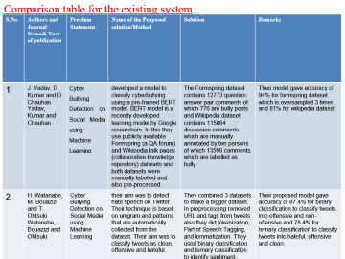
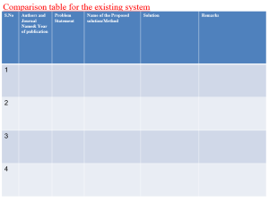
Literature Review
Notes:
13

Slide 14
Comparison table for the existing system
S.No | Authors and Journal Name& Year of publication | Problem Statement | Name of the Proposed solution/Method | Solution | Remarks
1 | J. Yadav, D. Kumar and D. Chauhan Yadav, Kumar and Chauhan | Cyber Bullying Detection on Social Media using Machine Learning | developed a model to classify cyberbullying using a pre-trained BERT model. BERT model is a recently developed learning model by Google researchers. In this they use publicly available Formspring (a QA forum) and Wikipedia talk pages (collaborative knowledge repository) datasets and both datasets were manually labelled and also pre-processed . | The Formspring dataset contains 12773 question-answer pair comments of which 776 are bully posts and Wikipedia dataset contains 115864 discussion comments which are manually annotated by ten persons of which 13590 comments which are labelled as bully. | Their model gave accuracy of 94% for formspring dataset which is oversampled 3 times and 81% for wikipedia dataset
2 | H. Watanabe, M. Bouazizi and T. Ohtsuki Watanabe, Bouazizi and Ohtsuki | Cyber Bullying Detection on Social Media using Machine Learning | their aim was to detect hate speech on Twitter. Their technique is based on unigram and patterns that are automatically collected from the dataset. Their aim was to classify tweets as clean, offensive and hateful | They combined 3 datasets to make a bigger dataset. In preprocessing removed URL and tags from tweets also they did tokenization, Part of Speech Tagging, and lemmatization. They used binary classification and ternary classification to identify sentiment-based features, semantic features, Unigram features and pattern feature | Their proposed model gave accuracy of 87.4% for binary classification to classify tweets into offensive and non-offensive and 78.4% for ternary classification to classify tweets into hateful, offensive and clean.
3 | Noviantho, S. M. Isa and L. Ashianti Noviantho et al. | Cyber Bullying Detection on Social Media using Machine Learning | created a classification model for cyberbullying using Naive Bayes method and Support Vector Machine (SVM) | The data set they used was collected from Kaggle which provides 1600 conversations in Formspring.me in which question and answer are used as labels. This consists of 12729 data of which 11661 data is labeled noncyberbullying and 1068 is labeled cyberbullying. In data cleaning they removed the words like ‘haha’, ‘hehe’ , ‘umm’ etc. | For balancing dataset they formed classification: 2 classes(cyberbullying and non -cyberbullying), 4 classes (non-cyberbullying, cyberbullying with low, middle and high severity level), 11 classes (non-cyberbullying, cyberbullying with 1-10 severity level).
4 | Aditya Gaydhani,Doma et al. Gaydhani, Doma, Kendre and Bhagwat | Cyber Bullying Detection on Social Media using Machine Learning | , implemented a model for detecting hate speech and offensive language on twitter using machine learning. Datasets were taken from crowd flower and GitHub. | The dataset was then split into 70% training and 30% test samples. N-gram features from the tweets were extracted and were weighed according to their TF IDF values. Unigram, Bigram and Trigram features along with L1 and L2 normalization of TF IDF were considered. | Logistic Regression, Naïve Bayes and Support vector machine algorithms were compared. 95% accuracy was obtained using Logistic Regression with L2 Normalization and n=3.

Slide 15
Comparison table for the existing system
S.No | Authors and Journal Name& Year of publication | Problem Statement | Name of the Proposed solution/Method by authors | Solution | Remarks
5 | Lida Ketsbaia, Biju Issac et al. Ketsbaia, Issac and Chen | Cyber Bullying Detection on Social Media using Machine Learning | Logistic Regression, Linear SVC, Multinomial and Bernoulli classifiers were applied in unigrams, bigrams and trigrams. | A dataset created by the University of Maryland and Cornell University of about 35000 and 24000 tweets respectively was used with tweets labelled as Hate and Non hate. Tweets were converted into lowercase, numbers, URLs and user mentions, punctuations, special characters and stop words were removed and contradictions were replaced. Dataset was then balanced. | Accuracy of 95% and 96% was achieved for the datasets.
6 | Cynthia Van Hee , Gilles Jacobs Van Hee, Jacobs, Emmery, Desmet, Lefever, Verhoeven, De Pauw, Daelemans and Hoste | Cyber Bullying Detection on Social Media using Machine Learning | automatic cyberbullying detection in social media text by modelling posts written by bullies, victims by standards of online bullying. | two corpora were constructed by collecting data from social networking sites like Ask. fm. developed a model using tokenization, PoS-tagging, and lemmatization for preprocessing. Models were developed for English and Dutch to test for language conversion and subsequent accuracy | ML algorithm SVM gave the accuracy for the English language - 64% and for the Dutch language - 61%
7 | Mohammed Ali Al-Garadi, et al. Al-Garadi, Hussain, Khan, Murtaza, Nweke, Ali, Mujtaba, Chiroma, Khattak and Gani | Cyber Bullying Detection on Social Media using Machine Learning | ML algorithms using SVM , K clustering, Random forest, Decision Trees | , implemented a model to reduce textual cyberbullying because it has become the dominant aggressive behaviour in social media sites. They extracted data from Wikipedia, you- tube Twitter, Instagram and developed a model using tokenization lemmatization and N-gram was used up to 5 levels to calculate TF IDF and count vector for pre-processing | They gave a comparative analysis of ML algorithms using SVM , K clustering, Random forest, Decision Trees and concluded that SVM worked best amongst the four machine learning models.
8 | Kshitiz Sahay,et al. Sahay, Khaira, Kukreja and Shukla | Cyber Bullying Detection on Social Media using Machine Learning | The data set they used was obtained from Wikipedia, YouTube, Twitter. In preprocessing removed URL and tags from data set and performed Count Vectors and TF- IDF vectors. For classification they used Logistic Regression, SVM, Random Forest and Gradient Boosting. | Their focus was to identify and classify bullying in the text by analyzing and studying the properties of bullies and aggressors and what features distinguish them from regular users. | Logistic Regression, Naïve Bayes and Support vector machine algorithms were compared. 95% accuracy was obtained using Logistic Regression with L2 Normalization and n=3.

Slide 16
Implementation of Existing System
CNN-BiLSTM deep learning detection model
It can detect cyberbullying content in tweets posted by users in three different languages in real time data.
A multilingual dataset is built, apart from English(Latin script) and Hindi(Devanagari script), Hinglish (Latin script- where Hindi words are written using English alphabets) is also included, which makes up most of the tweets from users who tweet in Hindi.
This proposed model works for on real-time data and the web portal that is created will be like a clone of social media websites like Twitter, where one can post their tweets, and the change will be reflected in the feed. This site will assess if the posted tweet contains cyberbullying content by running it through our model.

Slide 17
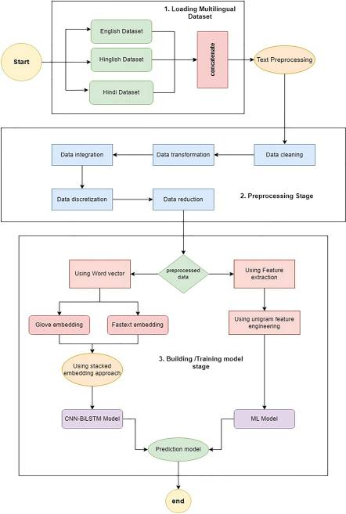

Slide 18
Result
Accuracy refers to the proportion of correct predictions made by the model.
Accuracy= Correct Prediction/ Total Prediction.
Adam and RMSProp as optimizers are used and for activation layers ReLU and Sigmoid are used thus making it a total of 4 combinations.
The activation function chosen has a significant effect on the neural network’s capabilities and performance, and various activation functions may be utilized in various portions of the model. The sigmoid function converts any input into a number between 0 and 1. The function sigmoid gives the result near to zero for small values, and a value close to one for high values.
The Adam optimizer is computationally more efficient, requires slight memory, is invariant to diagonal resizing of gradients, and it is well suited for problems with a lot of data/parameters, whereas the RMSProp optimization algorithm keeps the sections under control the entire time because of the decay rate, which makes RMSProp faster than Adam.

Slide 19
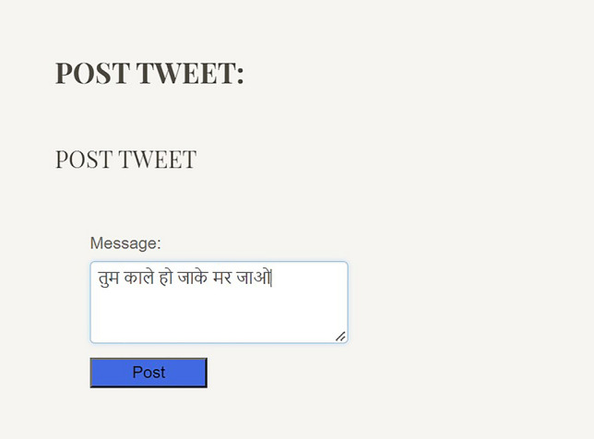
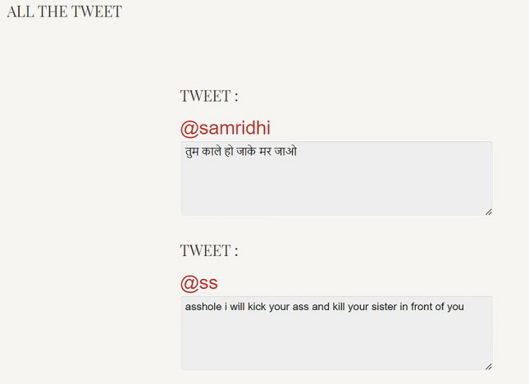
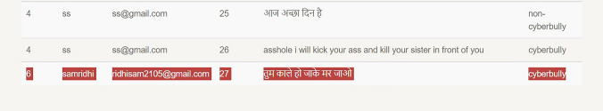

Slide 20
Conclusion
In conclusion, utilizing machine learning for cyberbullying detection holds great promise in addressing the pervasive issue of online harassment and promoting a safer and more inclusive digital environment. while machine learning offers promising solutions for detecting and mitigating cyberbullying, it is important to approach this challenge with a holistic perspective that encompasses ethical considerations, privacy concerns, and the goal of fostering a more respectful and supportive online community. Continued research, innovation, and collaboration are essential to effectively combat cyberbullying and make online spaces safer for all users.

Slide 21
References
[1] Rice, Eric, et al. “Cyber bullying perpetration and victimization among middle-school students.” American Journal of Public Health (ajph), pp. e66-e72, Washington, 2015.
[2] Bangladesh Telecommunication RegulatoryCommission, http://www.btrc.gov.bd/content/internet-subscribers-Bangladeshjanuary-2018, [Last Accessed on 18 Mar 2018].
[3] Mandal, Ashis Kumar,Rikta Sen. "Supervised learning methods for Bangla web document categorization." International Journal of Artificial Intelligence & Applications, IJAIA, Vol 5, pp. 5, 10.5121/ijaia.2014.5508
[4] Dani Harsh, Jundong Li, and Huan Liu, “Sentiment Informed Cyberbullying Detection in Social Media” Joint European Conference on Machine Learning and Knowledge Discovery in Databases. Spinger, Cham, 2017
[5] Dinakar, Karthik, Roi Reichart, and Henry Lieberman. “Modeling the detection of Textual Cyberbullying.” The Social Mobile Web 11.02(2011):11-17

Slide 22
Thank You!

